Slide 1

Forecasting tax avoidance rates by international listed companies
- using shallow Machine Learning techniques
Authors: Michał Woźniak & Michał Wrzesiński

Slide 2
Agenda
Introduction - problem description
Materials and methods
  Dataset description
  General methodology of research
Machine learning journey
  Exploratory Data Analysis
  Feature engineering
  Feature selection
  Models: Naive model, OLS model, ARMA model, ARDL model, KNN model, SVR model
Final results and conclusions

Slide 3

Introduction - problem description
Research goal
In this study, we will check whether we can forecast for one year ahead the level of tax avoidance by a group of companies listed on stock exchanges using shallow Machine Learning models.
Tax avoidance definition
Tax avoidance consists in carrying out economic activities in such a way that they are understood in a different way from tax regulations, in order to reduce the tax burden.
Importance of research
Forecasting such a phenomenon may be particularly important for the tax authorities and legislators. It helps to create rules that would fight against tax avoidance.
Tax avoidance metric
The most popular one is Effective Tax Rate . Due to this formula, ETR has values in the range [0,1]. The lower the ETR, the more likely the company is to avoid taxation.
Class of the problem and evaluation metrics of models
Based on research goal this problem is a classic panel problem (many companies and many years). To evaluate our products we chose metrics like: Mean Absolute Error (MAE), Root Mean Square Error (RMSE).

Slide 4
Materials and methods - dataset description
Source
The database used in the study was created for the purposes of the paper "Determinants of multinational tax avoidance" (Agnieszka Teterycz, PhD. Anna Białek) on the basis of data retrieved from the Bloomberg database, OECD and PWC reports.
Observations
The dataset gathers companies included in WIG, DAX, UK100, CAC40 and ATX indices listed on stock exchanges in Poland, Germany, Great Britain, France and Austria in 2005-2017. Yearly Data!
Dimensions
13 years x 363 companies (balanced panel data) x 33 variables (in the raw dataset)
Features
Variables are initially divided into two groups: baseline variables and financial transformations on baseline variables. All variables are purely financial. A significant part of them are fundamental variables. All variables were selected based on literature. The full list of variables is on the next slide.

Slide 5
Materials and methods - dataset description
All initial features in the dataset
company ticker from stock exchange
business sector of a company
year
the stock exchange from which the company originates
total assets of a company
total tax expenses of a company
pre-tax income of a company
statutory tax rate of a company
research and development expenditure of a company
net income of a company
property plant and equipment net of a company
total intangible assets of a company
long term debt of a company
short term debt of a company
capital expenditures of a company
revenue of a company
cash and cash equivalents of a company
advertising expenses of a company
effective tax rate of a company
statutory tax rate - effective tax rate
control foreign companies by a company [yes/no]
double taxation agreements [yes/no]
return of assets of a company
leverage of a company
intangible assets/total assets
research and development expenditure/total assets
property plant and equipment/total assets
log(revenue of a company/total assets)
cash and cash equivalents of a company/total assets
advertising expenses/total assets
capex/property plant and equipment
scaled capex2

Slide 6
Materials and methods - general methodology of research
Dataset adjustment and split:
ETR shifting
train (& validation) dataset - 2005 - 2015 (exogenous notation) x 364 companies
test (out of sample / out of time) dataset - 2016 (exogenous notation) x 364 companies
Test dataset will be used only for the final predictions!
Models
forecasting methodology: one step ahead
class of models: naive model (y_t = y_{t-1}), OLS (without time dependent variables), ARMA, ARDL (OLS with time dependent variables), KNN, SVR
Winner obtaining
We will find the best model (variables and hyperparameters) within each model class on the training and validation set, and at the end we will evaluate their results on the test set to select champion.
Cross-validation:
In case of final comparison of models inside a specific class of models we applied „proper CV” - we will treat it like a panel problem with a rolling window.
Sliding window:
  T: 2005 - 2008; V: 2009
  T: 2005 - 2009; V: 2010
  T: 2005 - 2010; V: 2011
  ...

Slide 7
Machine learning journey

Slide 8
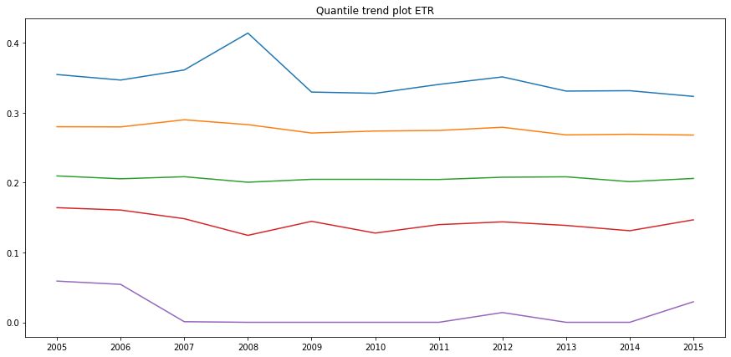
Exploratory Data Analysis

Slide 9
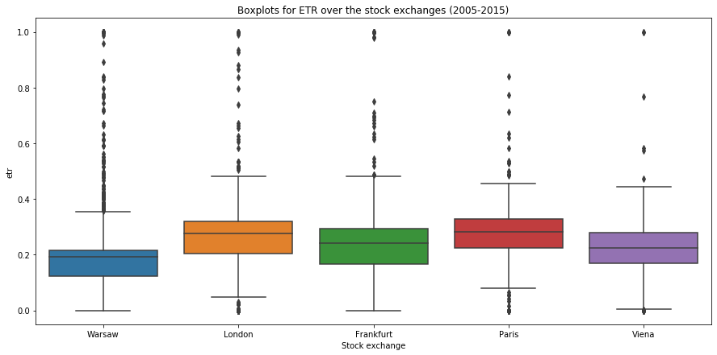
Exploratory Data Analysis

Slide 10
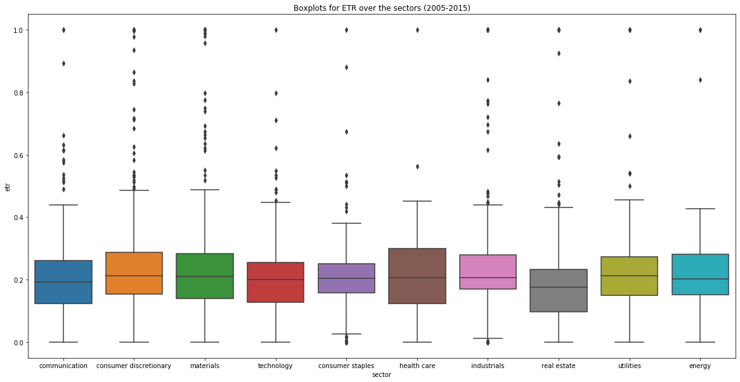
Exploratory Data Analysis

Slide 11
Feature engineering
Feature engineering during ETL
We created additional features based on three sources:
First source: World Bank, V-Dem index, Polity index, BR index - democracy indices (proxy for investment moods), GDP growth, GDP per capita and Inflation (proxy for business cycle)
Second source: main stock market indexes for Poland (WIG), Germany (DAX), Great Britain (FTSE), France (CAC) and Austria (ATX) – yearly stock returns
Third source: S&P indexes for sectors - yearly stock returns
Feature engineering after ETL
one dimensional approach
  logarithm
  square root
  power
  clipping
  discretization using shallow Univariate Decision Trees
  one hot encoding
interactions
time-series approach
  Dependent variable lagging based on autoARIMA model (significance of AR process)
  Independent variables lagging based on autoARIMA model (significance of AR process)
  Moving Avarage of dependent variable based on autoARIMA model (significance of MA process)
  Moving Avarage of independent variables based on autoARIMA model (significance of MA process)

Slide 12
Feature selection
The selection of variables for the model was carried out individually for each model class.
The feature selection process is divided into two stages.
The first stage was to create ranking of variables based on many techniques:
Univariate approach:
  Variance Threshold, Mutual Information, F-test, Spearman Correlation
Wrapper methods:
  Elastic Net, Boruta
The second stage was carried out individually for each model:
OLS feature candidates based on:
  Elastic Net
  Recursive Feature Elimination
  Permutation importance
  Forward elimination
ARDL feature candidates based on:
  Elastic Net
  Boruta
  Recursive Feature Elimination
  Permutation importance
  Forward elimination
KNN feature candidates based on:
  Elastic Net
  Mutual Information
  Spearman Correlation
  Relief
  Forward elimination
SVR feature candidates based on:
  Elastic Net
  Boruta
  Mutual Information
  Recursive Feature Elimination
  Permutation importance
  Forward elimination

Slide 13
Modeling – main approach
We applied following general approach for each class of models:
we performed additional feature engineering – standardization
we found "good enough" parameters (in CV) to proceed feature selection procedure
we applied feature selection procedure based on previously mentioned techniques and after that we generated groups of feature candidates
then tuned hyperparameters for each group of variables (in CV) - we obtained couple of models
then we compared all models based on so called "proper CV"
Disclaimer
We are aware of potential data leakage in case of usage KFold CV without time-series problem handling (in point 2, 3 and 4). To be honest in this problem it is not a big deal - based on our experience and we treat it like a feature!
During the last step of our procedure we verified previous analysis based on "proper CV" which handle time-series properties!!! So during hyperparameters tuning we will use different CV (we fight against data leakage).

Slide 14
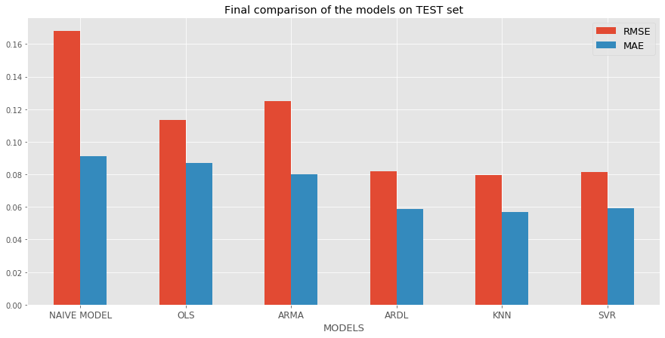
Final results and conclusions
 | RMSE | MAE
NAIVE MODEL | 0.167860 | 0.091059
OLS | 0.113211 | 0.087110
ARMA | 0.124843 | 0.080011
ARDL | 0.082121 | 0.058620
KNN | 0.079783 | 0.056937
SVR | 0.081393 | 0.059047

Slide 15
Final results and conclusions
Based on final scores we see that:
naive model have been beaten by all models
ARMA approach without additional exogenous variables was better than naive model
OLS approach without additional time-related exogenous variables was better than naive model
when we combined both approaches: static exogenous variables + time-related exogenous variables in ARDL model we obtained better model!
our best SVR (rbf) was better than ARDL but only a little bit (insignificantly)
our KNN outperformed all models!
We recommend in the business environment usage of ARDL model: cheaper - computational time, fully explainable and has less variables!
Variables in final ARDL model:
log(revenue of a company/total assets), control foreign companies by a company, etr_MA(2), (statutory tax rate - effective tax rate)_positive, total tax expenses of a company (levels: (-34.811, 0.488], (0.488, 24.415], (308.55, 327.531]),
pre-tax income of a company (level: (7875.5, 8108.5]), statutory tax rate of a company (level: (0.28, inf]), long term debt of a company (level: (176.129, 200.9])

